Slide 1
Integrating Primary and Secondary Resources into Literacy
Arkansas Reading Association Conference
November 17, 2016
Ms. Denise E. Taylor, Principal
Mountain Pine High School

Slide 2
Objective:
By the end of the session the participants will be able to demonstrate an understanding between a primary and secondary resource.
The participants will incorporate photographs, video footage, newspaper, magazine articles, postcards, paintings and maps into their literacy units to make text to world connections.

Slide 3
What is a Primary Source?
A document or physical object which was written or created during the time under study.
Primary sources enable researchers to get as close as possible to what actually happened during an historical event and/or time period.
Examples:
Original Documents: diaries, speeches, manuscripts, letters, interviews, news film footage, autobiographies, official records
Creative works: Poetry, drama, novels, music, art
Relics or Artifacts: pottery, furniture, clothing, buildings

Slide 4
What is a Secondary Resource?
Interprets and analyzes primary sources. One or more steps removed from the event. May have pictures, quotes, graphics, or primary sources in them.
Examples:
Textbooks
Magazine articles
Histories
Criticisms
Commentaries
Encyclopedias

Slide 5
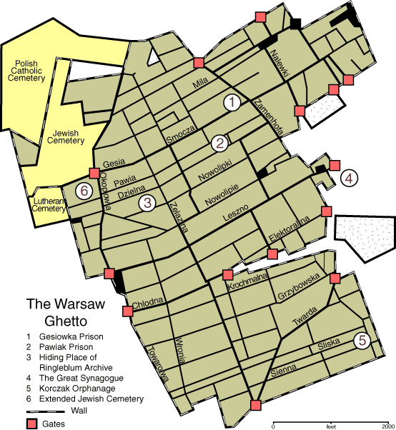
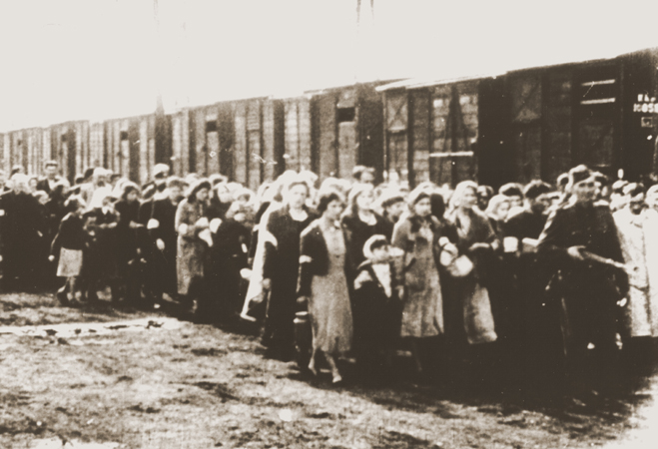
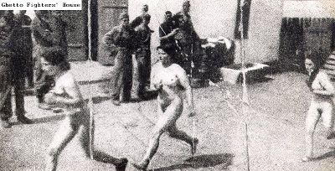
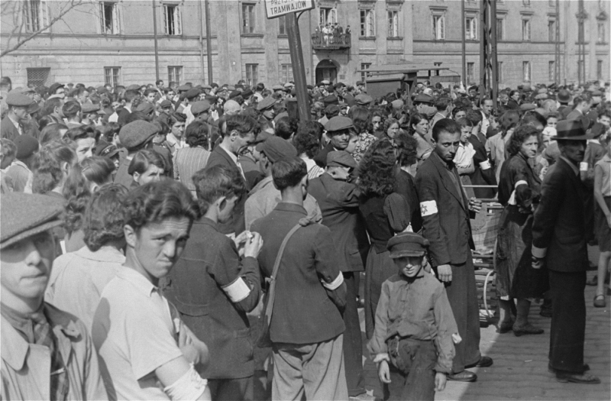
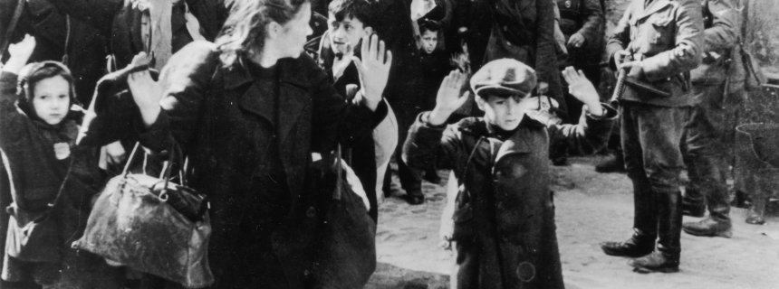
Primary Source: Night

Slide 6
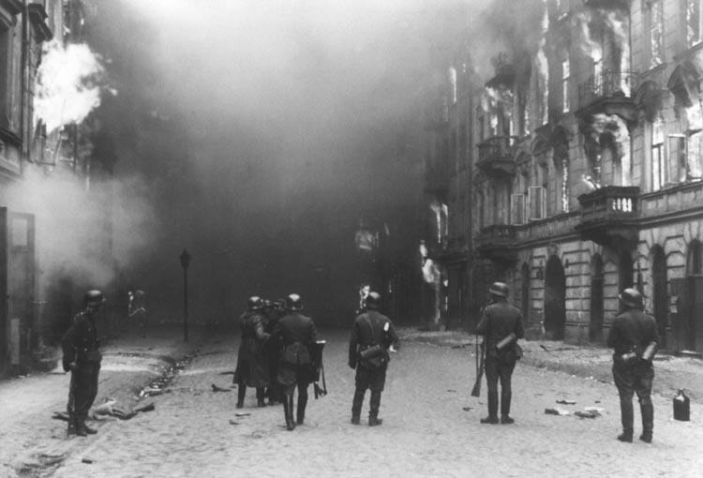
Warsaw Ghetto Uprising
https://www.youtube.com/watch?v=qhlwy6d8vBk

Slide 7
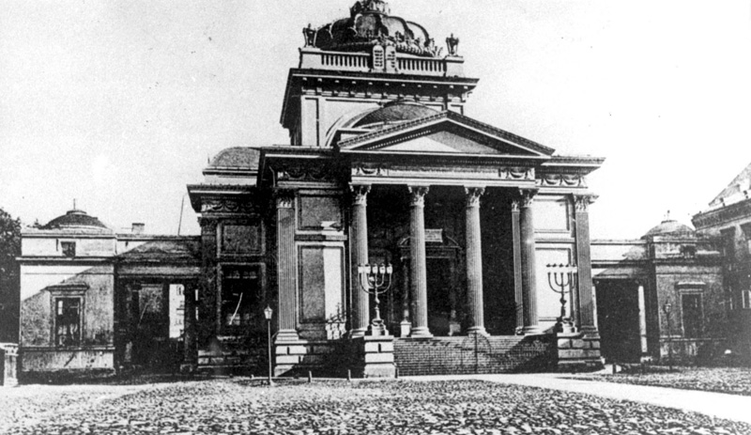
Poetry
This poem was written by Pavel Friedmann, at Theresienstadt concentration camp on 4 June 1942. On September 29, 1944 he was deported to Auschwitz where he died.
The Butterfly #2
The last, the very last,
So richly, brightly, dazzlingly yellow.
Perhaps if the sun's tears would sing
against a white stone...
Such, such a yellow
Is carried lightly ‘way up high.
It went away I'm sure because it wished
to kiss the world goodbye.
For seven weeks I've lived in here,
Penned up inside this ghetto
But I have found my people here.
The dandelions call to me
And the white chestnut candles in the court.
Only I never saw another butterfly.
That butterfly was the last one.
Butterflies don't live in here,
In the ghetto.

Slide 8
For almost a month the Jews of the Warsaw Ghetto fought for their lives. Many of them perished in the fires and smoke of the uprising. Others were murdered in the ghetto streets. The remainder were sent to Treblinka, Majdanek, and other camps in the Lublin area. Few managed to escape to the Aryan side of Warsaw. The ghetto was transformed into a wasteland.
http://www.yadvashem.org/yv/en/exhibitions/warsaw_ghetto_testimonies/liquidation.asp

Slide 9
Think-Pair-Share
With a partner discuss the use of the resources already discussed/viewed.
Answer with your partner: how the use of the photographs, videos, and poetry can help the students make the text to world connections and bring the time period to life?
How would bringing WWII to life with this novel help students to understand what is happening in the world today? What text to world connections can students make to today’s world issues?

Slide 10
Research Activity
With your table group using your own laptop or phone:
Look at the novel you have been given. Is it a primary or a secondary resource?
Find with your group 3-5 additional primary sources using the internet that could be used to bring the novel to life and make text-to-text, text-to-self, or text-to-world connections.
All groups will report out.
10 minutes

Slide 11
Group Report Out
How many primary resources were you able to locate?
How will you use more primary resources in your classes?
What benefit do you see to using phots, videos, letters, speeches, etc…?

Slide 12
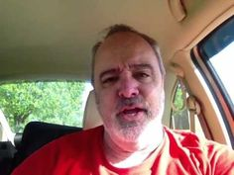
Happy Holidays
https://www.youtube.com/watch?v=BxtCw_ucqOQ

Slide 13
Thank You

