Slide 1
Charlie May Simon 2018-2019
Reading List
ALLPPT.com _ Free PowerPoint Templates, Diagrams and Charts

Slide 2
GUIDELINES
For students in grades four, five and six
Students must have read three books or have heard three books
Students vote for one book
It is hoped the children will discuss the books that they have read and as a result will become more thoughtful readers
One person at the school will collect the votes and submit the count to the Department of Education in early May

Slide 3
CRITERIA
Books on the 2018-2019 must have been published in 2016.
The author must reside in the United States.
Books published in a previous year or a foreign country will not be considered
Adaptations, retellings and translations will not be considered
The author must be living
Books that children will read anyways are generally not included.

Slide 4
CRITERIA
Books that are third in a series or beyond will not be considered
Books that fall in this category may be considered if recommended by a teacher, library media specialist or committee member.

Slide 5
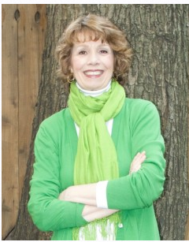
Soar
By Joan Bauer
Moving to Hillcrest, Ohio, when his
adoptive father accepts a temporary
job, twelve-year-old Jeremiah, a heart
transplant recipient, has sixty days to
find a baseball team to coach.

Slide 6
Soar
Genre – Realistic fiction, sports
Accelerated Reader RL 3.6 Pts 6
Reading Counts RL 3.1 Pts 12
Lexile 510L
DRA 50
Guided Reading
Word count 45,856
Pages
Christopher award
ILC Children’s Choices

Slide 7
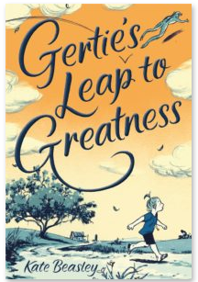
Gertie’s leap to greatness
By Kate Beasley
Gertie is a girl on a mission to be the best fifth grader ever in order to show her estranged mother that
Gertie doesn't need her--not one bit!

Slide 8
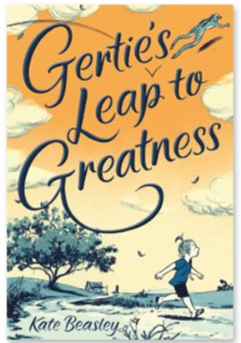
Gertie’s leap to greatness
Genre – Realistic fiction, Humor
Accelerated Reader RL 4.7 Pts 6
Reading Counts RL 4.4 Pts 10
Lexile 720
DRA 50
Guided Reading U
Word count 41,907
249 p. pages
First novel

Slide 9
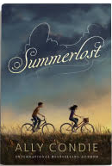
Summerlost
By Ally Condie
Following the sudden deaths of her father and autistic
younger brother, Cedar Lee spends the summer working at a Shakespearean theater festival, making a new friend, and coming to terms with her grief.

Slide 10
Summerlost
Genre – Realistic fiction
Accelerated Reader RL 4.1 Pts 6
Reading Counts RL 3.4 Pts 11
Lexile 600L
DRA 50
Guided Reading V
Word count 45,454
272 pages
Edgar Award Finalist 2016 Best Juvenile Mystery
First Middle School Novel

Slide 11
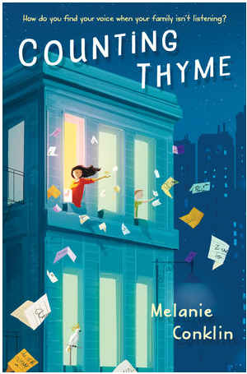
Counting thyme
By Melanie Conklin
Thyme Owens moves across the country with her family so her younger brother can take part in a promising cancer drug trial, and though all she wants is for him to get better, adjusting to
life in Manhattan is anything but easy.

Slide 12
Counting thyme
Genre – Realistic fiction, Contemporary fiction
Accelerated Reader RL 4.5 Pts 10
Reading Counts RL 4.2 Pts 18
Lexile 680
Guided Reading
Word count 71,213
Pages
A Bank Street Best Children’s Books of the Year Selection 2017
SCBWI Crystal Kite Awards Finalist 2017
International Literacy Association’s Teachers’ Choices Selection 2017

Slide 13
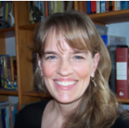
All rise for the Honorable Perry T. Cook
by Leslie Connor
A powerful middle-grade novel about a boy who was born and raised in the Blue River County Coed Correctional
Facility of Surprise, Nebraska.

Slide 14
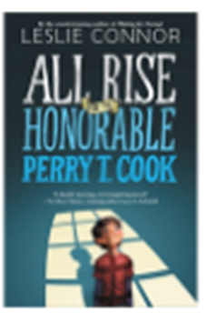
All rise for the Honorable Perry T. Cook
Genre - Mystery
Accelerated Reader RL 3.8 Pts 11
Reading counts RL 3.2 PTS 17
Lexile 540
DRA 60
Guided reading W
Word Count 80,817
400 Pages

Slide 15
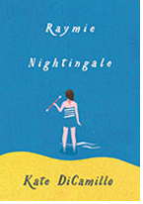
Raymie Nightingale
By Kate DiCamillo
Raymie Clarke has a plan. If Raymie can win the Little Miss
Central Florida Tire competition, then her father, who left
town two days ago with a dental hygienist, will see Raymie's picture in the paper and (maybe) come home.

Slide 16
Raymie Nightingale
Genre – Historical Fiction or Realistic fiction
Accelerated Reader RL 4.2 Pts 5
Reading Counts RL 3.2 Pts 9
Lexile 550
Guided Reading U
DRA 50
Word Count 33,384
263 pages
2017 Notable Children’s Books

Slide 17
Some kind of courage
By Dan Gemeinhart
In 1890 Washington the only family Joseph Johnson has left
is his half-wild Indian pony, Sarah, so when she is sold by a man who has no right to do so, he sets out to get her back--and he plans to let nothing stop him in his quest.

Slide 18
Some kind of courage
Genre – Historical fiction, Adventure
Accelerated Reader RL 4.8 Pts 8
Reading Counts RL 4.6 Pts 13
Lexile 760L
DRA 50
Guided Reading V
Word count 53,738
234 pages
Second book

Slide 19
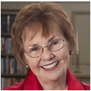
Jubilee
By Patricia Reilly Giff
Judith stopped talking long ago when Mom left her in the
care of beloved Aunt Cora. Going back into a regular
fifth-grade classroom won't be easy, but she has her Dog
and new friend who will help her through.

Slide 20
Jubilee
Genre – Realistic fiction
Accelerated Reader RL 4 Pts 3
Reading Counts RL 3.2 Pts 7
Lexile 540
Guided Reading T
Word count 23,353
149 pages
ILA-CBC Choices Reading Lists, Children’s Choices

Slide 21
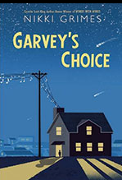
Garvey’s Choice
By Nikki Grimes
When Garvey joins the chorus at school his newly discovered talent for singing gives him both the confidence to accept
himself and a language his father will finally understand--the language of music.

Slide 22
Garvey’s Choice
Genre – Poetry, realistic fiction
Accelerated Reader RL 3.6 Pts 1
Reading Counts RL 3.5 Pts 4
Lexile 620
DRA 50
Guided Reading T
Word Count 4,680
108 Pages
2017 Notable Children's Book Bank Street College of Education Best Books of the Year list
Booklist Top 10 Contemporary Middle Grade Novel Booklist: Top 10 Diverse Fiction List
Lee Bennett Hopkins Poetry Award Honor 2017

Slide 23
Full of beans
By Jennifer L. Holm
Ten-year-old Beans Curry, a member of the Keepsies, the
best marble playing gang in Depression-era Key West,
Florida, engages in various schemes to earn money while
"New Dealers" from Washington, D.C., arrive to turn run
down Key West into a tourist resort.

Slide 24
Full of beans
Genre – Historical fiction
Accelerated Reader RL 3.8 Pts 4
Reading Counts RL 2.6 Pts 9
Lexile 490
Guided Reading
Word Count 28,064
Pages
Scott O’Dell Award
2017 Notable Children’s Books

Slide 25
A Bandit’s tale: the muddled misadventures of a pickpocket
By Deborah Hopkinson
In March of 1887, Rocco, an eleven-year-old from an Italian
village, arrives in New York City where he is forced to live in squalor and beg for money as a street musician, but he finds the city's cruelty to children and animals intolerable and sets out to make things better, whatever the cost to himself.

Slide 26
A Bandit’s tale
Genre – Historical fiction
Accelerated Reader RL 5.1 Pts 9
Reading Counts RL 4.5 Pts 14
Lexile 740
Guided Reading W
Word count 57,408
290 pages

Slide 27
Skunked! Calpurnia Tate, Girl vet
By Jacqueline Kelly
When Travis discovers an abandoned baby skunk, he can't
help but bring it home and take care of it. Stinky, as Travis
names him, settles in pretty well. But when Travis discovers
Stinky's litter-mate, Winky, who is in need of some help,
things get complicated around the Tate house.

Slide 28
Skunked! Calpurnia Tate, Girl vet
Genre – Historical fiction
Accelerated Reader RL 4.5 Pts 1
Reading Counts RL 4.5 Pts 5
Lexile 740
DRA 34
Guided Reading O
Word count 8,145
106 pages

Slide 29
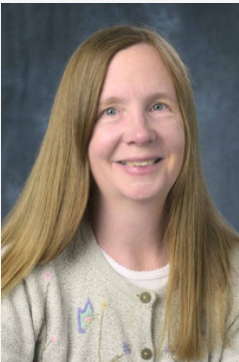
Write this down
By Claudia Mills
Twelve-year-old Autumn wants more than anything to be a
real author, but when she wins a contest by writing
something too personal about her brother, she has to decide if her dreams are more important than their relationship.

Slide 30
Write this down
Genre – Realistic fiction
Accelerated Reader RL 5.7 Pts 8
Reading Counts RL
Lexile 890
Guided Reading
Word count 48,550
248 pages

Slide 31
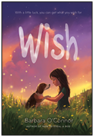
Wish
By Barbara O’Connor
A story about a girl who, with the help of the dog of her
dreams, discovers that family doesn't always have to be
related--they are simply people who love you for who you
are.

Slide 32
Wish
Genre –Realistic fiction
Accelerated Reader RL 5 Pts 6
Reading Counts RL 5.5 Pts 11
Lexile 850
DRA 50
Guided Reading S
Word count 42,116
227 pages

Slide 33
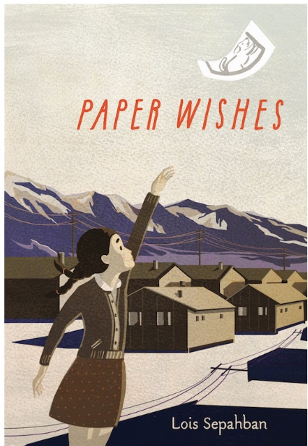
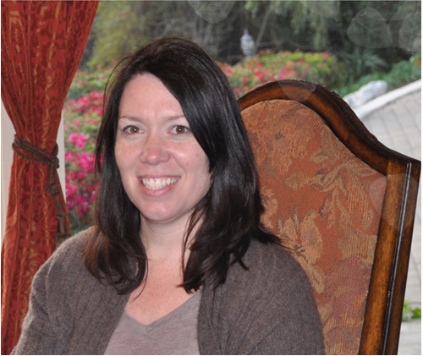
Paper wishes
By Lois Sepahban
Near the start of World War II, young Manami, her parents, and Grandfather are evacuated from their home and sent to Manzanar, an ugly, dreary internment camp in the desert for Japanese-American citizens.

Slide 34
Paper wishes
Genre – Historical fiction
Accelerated Reader RL 3.8 Pts 4
Reading Counts RL 3.2 Pts 8
Lexile 550
Guided Reading
Word count 28,219
181 pages

Slide 35
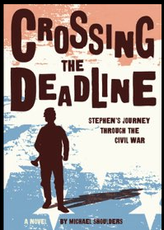
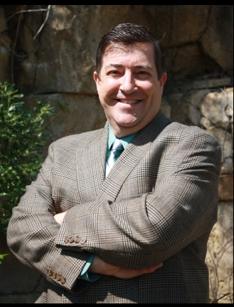
Crossing the deadline: Stephen’s journey through the Civil War
By Michael Shoulders
Stephen, an accomplished bugler in the town band, joins the Union effort in the Civil War and endures trial after trial,
from battle to Confederate prison and the shipwreck of the
steamboat Sultana, and through luck and fortitude, Stephen survives.

Slide 36
Crossing the deadline
Genre – Historical fiction
Accelerated Reader 4.8 Pts 10
Reading Counts RL
Lexile 730
Guided Reading
Word count 64,196
368 pages

