Slide 1

Indicators and Science Behind Teaching a Student with Dyslexia
Dyslexia Professional Awareness
Vicki King, M.Ed., CALT, QI
Arkansas Department of Education
Dyslexia Specialist

Slide 2
The Arkansas State Legislature
enacted Act 1294 of 2013, codified as A.C.A. § 6-41-601, Title 6, Subtitle 3, et al., to ensure that children with dyslexia
have their needs met by the public school system.

Slide 3
Components of the Law
A.C.A. § 6-41-601 Findings
A.C.A. § 6-41-602 Definitions
A.C.A. § 6-41-603 Required screening and intervention
A.C.A. § 6-41-604 Additional dyslexia evaluation and services
A.C.A. § 6-41-605 Instructional approaches
A.C.A. § 6-41-606 Reporting by school districts
A.C.A. § 6-41-607 Dyslexia Specialist
A.C.A. § 6-41-608 Dyslexia Professional Awareness
A.C.A. § 6-41-609 Dyslexia and related disorder education in teacher education programs
A.C.A. § 6-41-610 Dyslexia Resource Guide

Slide 4
Dyslexia Professional Awareness
A.C.A. § 6-41-608
No later than the 2014-2015 school year, the Department of Education shall ensure that each teacher receives professional awareness on
The indicators of dyslexia; and
The science behind teaching a student who is dyslexic.
The professional awareness may be provided:
Online;
At an education service cooperative; or
At another venue approved by the ADE
ArkansasIdeas online course:
Dyslexia: A Three Part Professional Development (1 hour credit)

Slide 5
A.C.A. § 6-41-601 Findings
Delayed identification is detrimental to a child’s academic success and self-esteem.
Dyslexia can be successfully treated.
Early identification and intervention is significantly less than the cost of intensive remediation.

Slide 6
Findings
Over 30 years of published research on dyslexia. One of the major sources - National Institute of Health (NIH).
Dyslexia represents one of the most common problems affecting children and adults.
Dyslexia is the most common and most carefully studied of the learning disabilities, affecting at least 80%of all individuals identified as having a specific learning disability.

Slide 7
National Institute of Health Study
NIH tracked 5,000 children from across the country beginning when they were 4 years old until they graduated.
They had no way to know which kids would develop reading difficulties.
The results of the study were released in 1994.

Slide 8
National Institute of Health Study
NIH researchers report that dyslexia impacts 10% of our population.
However, some researchers report numbers as high as 17-20%.
According to Yale University research, as many as one in five Americans have some degree of dyslexia, although only about 5 percent of children have been formally diagnosed.

Slide 9
The early identification of children at-risk for reading failure coupled with appropriate reading interventions can reduce the percentage of children reading below the basic level in 4th grade to 6% or less.
G. Reid Lyon

Slide 10
It takes 4 times as long to remediate a student with poor reading skills in fourth grade as in late kindergarten or early first grade.
NICHD – National Institute of Child Health and Development

Slide 11
A.C.A. § 6-41-602 Definitions
Dyslexia
Dyslexia Therapist
Dyslexia Therapy

Slide 12
A.C.A. § 6-41-602 Definitions
Dyslexia is a specific learning disability that is neurological in origin. It is characterized by difficulties with accurate and/or fluent word recognition and by poor spelling and decoding abilities. These difficulties typically result from a deficit in the phonological component of language that is often unexpected in relation to other cognitive abilities .

Slide 13
IDA’s Research Based Definition
Dyslexia is a specific learning disability that is neurological in origin. It is characterized by difficulties with accurate and/or fluent word recognition and by poor spelling and decoding abilities. These difficulties typically result from a deficit in the phonological component of language that is often unexpected in relation to other cognitive abilities and the provision of effective classroom instruction. Secondary consequences may include problems in reading comprehension and reduced reading experience that can impede the growth of vocabulary and background knowledge.
Adopted by the Board of Directors, International Dyslexia Association: November 2002

Slide 14

Defining dyslexia is a work in progress.

Slide 15
Historical Perspective
Word blindness (Kussmaul, 1877; Morgan, 1896)
Strephosymbolia (Orton, 1925)
Minimal Brain Injury/Perceptual deficits (Strauss, Cruikshank, mid 1900’s)
Specific Learning Disability (Kirk, 1963)
Specific Developmental Dyslexia (World Neurology Federation, 1968)

Slide 16
Specific Developmental Dyslexia
A disorder manifested by difficulty in learning to read
despite conventional instruction, adequate intelligence, socio-cultural opportunity. It is dependent upon fundamental cognitive disabilities which are frequently of constitutional in origin.
World Federation of Neurology, 1968

Slide 17
1968 Definition
Classification: Dyslexia is…
Characteristics: Manifested by…
Excluded as the cause: Despite…
Cause: Dependent upon…

Slide 18
Research Based Definition
Dyslexia is a specific learning disability that is neurological in origin. It is characterized by difficulties with accurate and/or fluent word recognition and by poor spelling and decoding abilities. These difficulties typically result from a deficit in the phonological component of language that is often unexpected in relation to other cognitive abilities and the provision of effective classroom instruction. Secondary consequences may include problems in reading comprehension and reduced reading experience that can impede the growth of vocabulary and background knowledge.
Adopted by the Board of Directors, International Dyslexia Association: November 2002

Slide 19
“Dyslexia is a specific learning disability”
One specific type of learning disability
May exist along with other conditions such as ADHD or an oral language disorder

Slide 20
“…neurological in origin”
When a person has dyslexia, their brain works or functions differently
The functional differences have been shown in fMRI studies
There are also size, structural and connectivity differences.

Slide 21
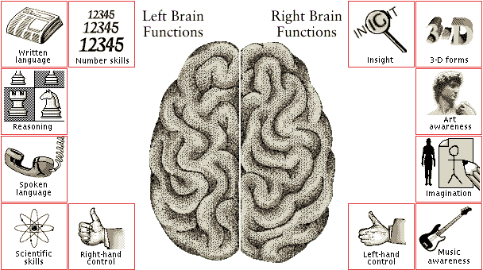
Notes:
Normal readers do not have symmetrical hemispheres …
In a typical reader, the left hemisphere--which is responsible for the many functions related to language use and reading--is usually 10% larger than the right.
But in an individual with dyslexia, the right hemisphere, which is associated with creativity, is as large as the left, which makes a dyslexic’s brain symmetrical.
Scientists believe this may be one reason people with dyslexia often have significant strengths in areas controlled by the right-side of the brain, such as artistic, athletic, and mechanical gifts; 3-D visualization ability; musical talent; creative problem solving skills; and …highly intuitive people skills.

Slide 22
What we know about neural pathways in good readers:
Inferior frontal gyrus
(articulation/word analysis)
Parieto-temporal
(phonology/word analysis)
Occipito-temporal
(visual/word form)
Notes:
Imaging studies have identified at least three neural pathways for reading located in the left hemisphere.
Two slower analytic regions are used mainly by beginning readers to initially analyze a word, pull it apart, and link the letters to the sounds:
1) Inferior frontal gyrus (Broca’s area)
2) Parieto-temporal
**the lower area of the parieto-temporal region processes speech sounds (phonology).
A speedier region serves as a hub where an experienced, skilled reader reacts almost instantly to the whole word as a pattern facilitating fluent reading.
3) Occipito-temporal

Slide 23
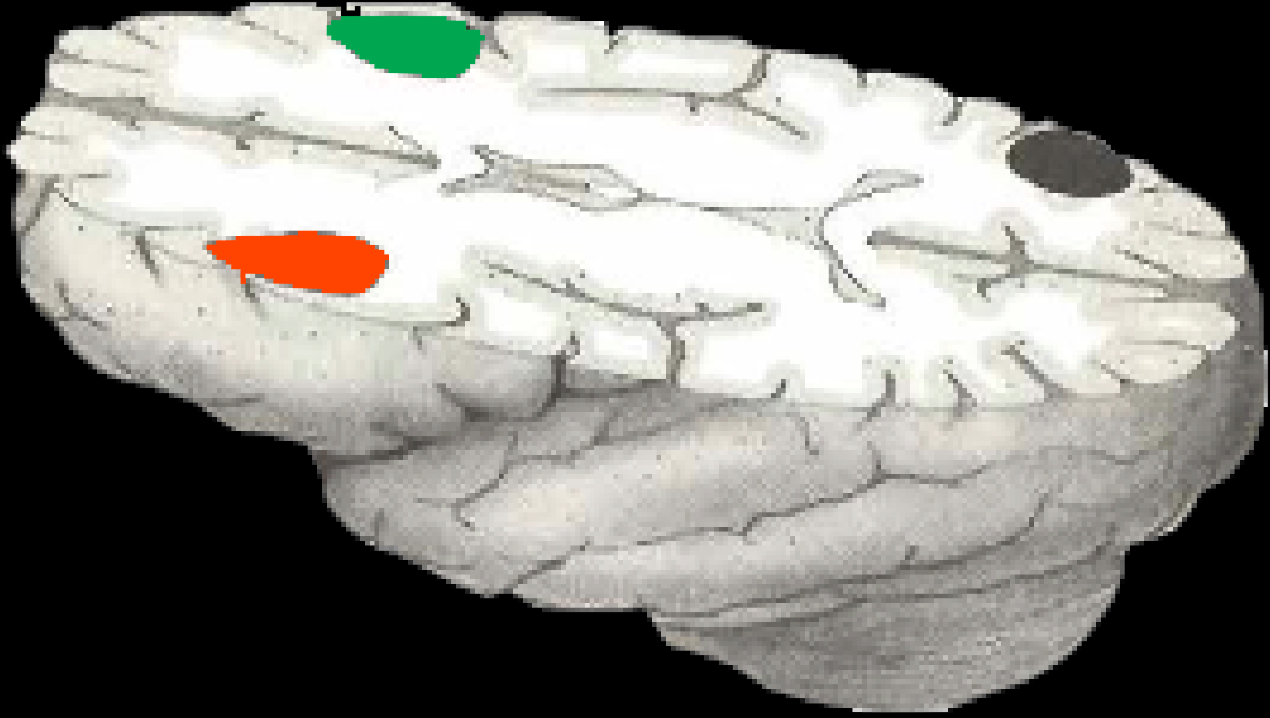
RIGHT
TYPICAL
LEFT
DYSLEXIC
Odegard, T.N. et al. (2008). Differentiating the neural response to intervention in children with developmental dyslexia. Annals of Dyslexia, 58, 1-14.
Notes:
When looking at a scan of a dyslexic brain, notice the activation in the inferior frontal gyrus, but notice the underactivation of the parieto-temporal region (phonology/word analysis) and occipito-temporal region (visual/word form). Also notice the activation of the right side.

Slide 24
“…characterized by difficulties with accurate and/or fluent word recognition and by poor spelling and decoding.”
Word-level reading difficulties are the core reading component of dyslexia.
Reflected in difficulty with rapid decoding and encoding and problems recognizing words automatically and fluently.
Poor spelling accompanies the reading difficulty.

Slide 25
“…difficulties typically result from a deficit in the phonological component of language…”
Phonological awareness reflects a metacognitive understanding that the words we hear and read have a sound-based structure.
When a child does not understand the relation between sound and print, word recognition will be delayed.

Slide 26
“…unexpected in relation to other cognitive abilities and the provision of effective classroom instruction”
The reading difficulties are not predicted by age, other cognitive abilities, or other academic abilities
Effective classroom instruction is important!
Monitoring how the student responds to good instruction can lead to earlier intervention.

Slide 27
“…secondary consequences may include problems in reading comprehension and reduced reading experience that can impede growth of vocabulary and background knowledge”
When word recognition requires great effort, there are fewer resources for comprehension.
If a child struggles to read, that child will read less.
A child who reads less learns fewer vocabulary words for reading comprehension.

Slide 28
2002 Research Based Definition
Classification: Dyslexia is…
Characteristics: Characterized by…
Excluded as the cause: Often unexpected…
Cause: Result from a…
Outcome: Secondary consequences may include…

Slide 29
Key Concepts
Dyslexia is a word reading problem
Core deficit is phonological processing
Primary difficulties
Decoding (phonics application)
  Poor spelling
Inadequate instruction and general cognitive deficits are exclusions
J. Black, M.D., 2011

Slide 30
Underlying Cause
Unexpected Relation
Phonological Awareness
Other cognitive abilities
Characteristics
Coexisting Complications
or Assets
Reading words in isolation
Decoding nonsense or unfamiliar words
Rate or Accuracy (Fluency)
Spelling
Language
Attention
Writing
Mathematics
Behavior/Emotions
Outcomes
Reading comprehension
Limited vocabulary and background knowledge

Slide 31
What are the primary reading characteristics of dyslexia?
Decoding (Nonsense or unfamiliar words)
  Word Identification (Real words)
Fluency
  Rate
  Accuracy
Spelling

Slide 32
What is the underlying cause of the reading/spelling deficits?
Phonological Processing

Slide 33
What is Phonological Processing?
Phonological Awareness
Phonological Memory
Rapid Naming

Slide 34
Phoneme
Fundamental or smallest element of speech
Single speech sound that can be recognized as being distinct from all other sounds in the language
44 sounds of the English language combine to make the thousands of English words

Slide 35
Phonics
Relating speech sounds (phonemes) to alphabet letters (graphemes)
Applying knowledge of this relationship to decode (sound out) written words

Slide 36
Phonological/Phonemic Awareness
Phonological awareness is the awareness of the sound structure of language.
Phonological awareness addresses the larger chunks of language:
words syllables onsets/rimes

Slide 37
Phonological/Phonemic Awareness
Metacognitive appreciation of the explicit sounds (phonemes) in spoken words
Demonstrated by listening and
- Blending spoken sounds
- Segmenting spoken words into sounds
- Manipulating spoken sounds
Strongest predictor of word reading success/failure
Strong evidence supports the causal link to dyslexia

Slide 38
Phonological Awareness or
Phonics?

Slide 39
What is the Alphabetic Principle?
Alphabetic understanding: Words are composed of letters that represent sounds.
Phonological recoding: Using systematic relationships between letters and phonemes to retrieve the pronunciation of an unknown printed string or to spell words.
Regular Word Reading
Irregular Word Reading
Advanced Word Analysis

Slide 40
What’s the big deal?
Successful readers have a well-developed phonological skill. The alphabetic principle of our writing code requires this ability. Therefore, a deficit in phonological awareness is the strongest predictor of reading failure and the underlying cause of dyslexia.

Slide 41
Phonological Memory
(Verbal Working Memory)
Storing, manipulating, and recalling verbal information
Demonstrated by tasks such as repeating a string of digits or repeating multisyllabic nonsense words
Difficult to determine unique contribution to dyslexia since phonemic awareness tasks involve some component of working memory.

Slide 42
Rapid Naming
Recall of names from long term memory
Demonstrated on timed naming tasks
Predictive of reading rate or fluent reading of words and text

Slide 43
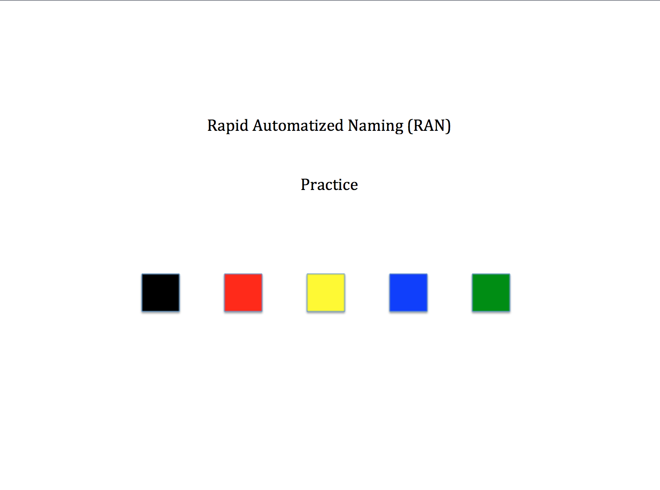
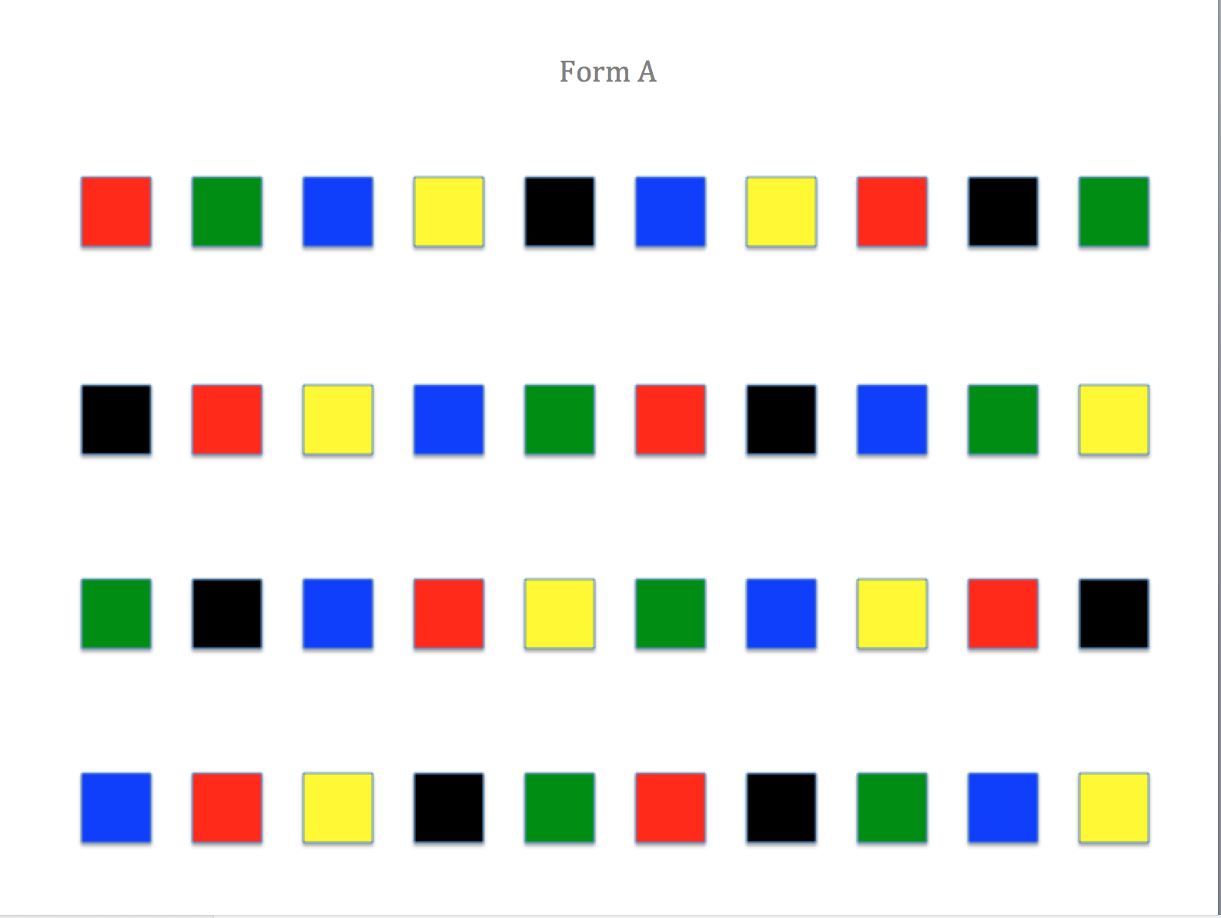
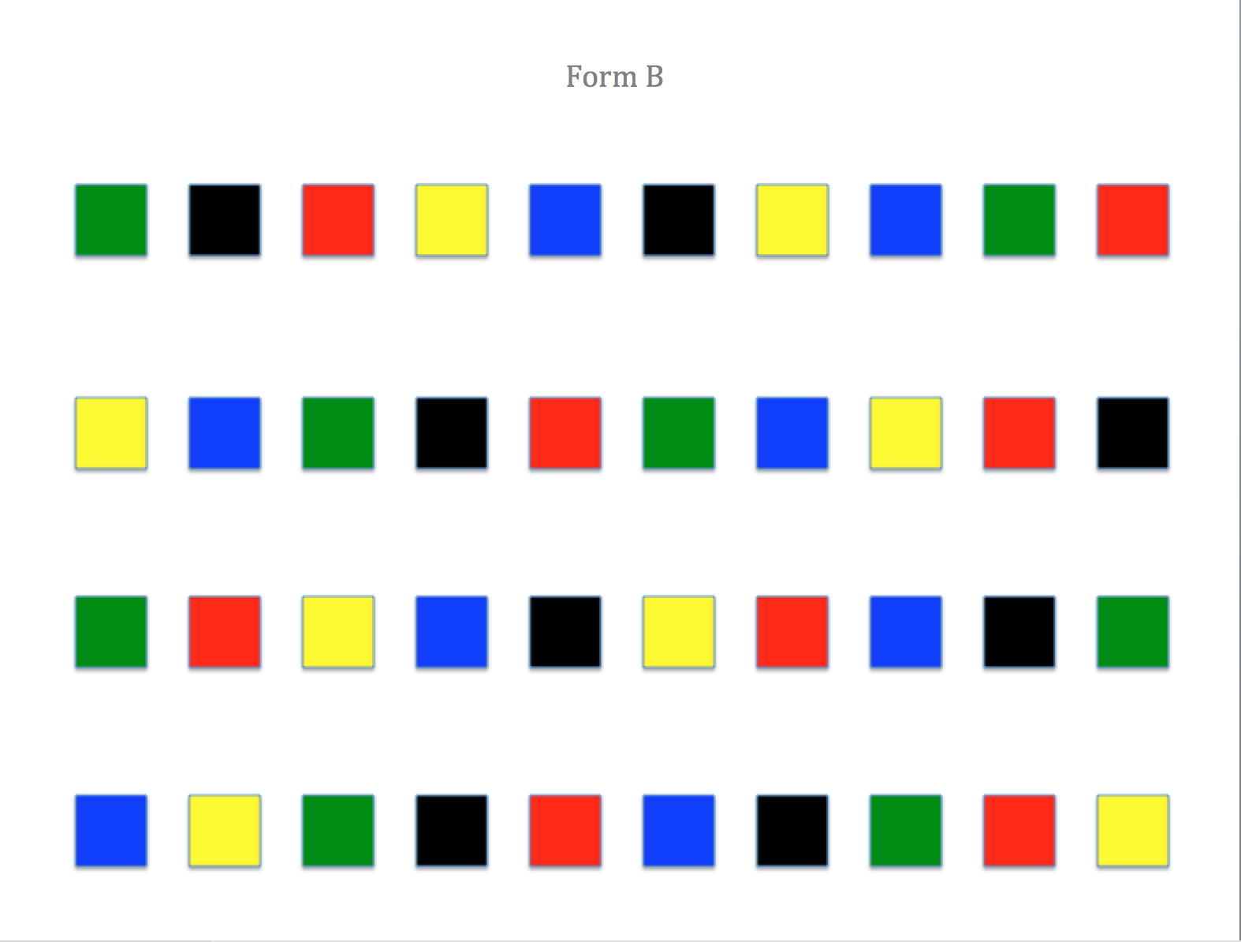
AR-RAN
Record the time it takes a child to read all four rows.
Combine the two times and rank by grade level to set district or campus norms.

Slide 44
Are the 3 phonological processing skills equally important in dyslexia identification?
Of the three phonological processing skills, phonological awareness is the strongest predictor of difficulty in word reading.
Phonological awareness deficits are the causal link to dyslexia

Slide 45
Phonological Awareness
Problems in Dyslexia
Words to sounds:
leaf (l-e-f) le-e-f
dough (d-o) d-o-uh
pen (p-e-n) p-e-p
wave (w-a-v) w-e-uh
skate (s-k-a-t) s-k-at
sight (s-i-t) s-si-sight

Slide 46
Word
Reading Development
Reading
Comprehension
Reading Fluency
Word Recognition
Decoding
Phonological Awareness

Slide 47
What can we do?
Recognize early indicators
Identify and intervene early
Provide appropriate instruction and accommodations

Slide 48
A.C.A. § 6-41-603 Required Screening and Intervention
Level 1: Universal Screener
Who is screened?
ALL K-2 students
          -This includes transfers from other districts and states
Any student in grades 3 -12 experiencing difficulty as noted by a classroom teacher

Slide 49
A.C.A. § 6-41-603 Required Screening and Intervention
What is the designated screening tool?
The Arkansas Department of Education shall adopt rules to ensure that students will be screened using DIBELS.

Slide 50
A.C.A. § 6-41-603 Required Screening and Intervention
What areas are to be assessed?
The screening should include:
Phonological and phonemic awareness;
Sound symbol recognition;
Alphabet knowledge;
Decoding skills;
Rapid naming skills; and
Encoding.

Slide 51
If DIBELS Screening indicates the need for intervention, the Response to Intervention (RTI) shall be used to address the needs of the student.
If RTI indicates the possibility of dyslexia, the student shall be evaluated.
A.C.A. § 6-41-603 Required Screening and Intervention

Slide 52
Tiers of Instruction
TIER 1
General Education (Core) Classroom Instruction
_________________
All Students
TIER 2
Strategic Instruction
(Intervention)
20- 30%
__________________
TIER 3
Comprehensive Assessment
__________________
Intensive Instruction
5-10 % _________________
With effective TIER 1 instruction
10 – 15%
Universal Screening /
Benchmark Assessments
Phonological awareness
Sound symbol recognition
Alphabet knowledge
Decoding skills
Rapid naming skills
Encoding skills
ID
Progress Monitoring
With effective TIER 2 instruction
5%
ID
Timothy N. Odegard PhD, CALP
Notes:
Speaker Notes:
Example of Fundations implementation in a Multi-Tier scenario – Tier 1 and Tier 2
Tier 1 Instruction: Fundations standard lesson occurs within the general education classroom and taught to all students.
Students identified as at-risk and in need of additional support (usually lowest 30th%) move into Tier 2.
Tier 2 Instruction: Students receive Double Dose Fundations lesson which involves targeted Fundations activities in small groups up to 30 minutes 3-5 times a week.
So, those students in Tier 2 are receiving the Fundations daily lesson plan with the whole class, AND additional Fundations instruction in small groups.
If students in Tier 2 do not respond to the double dose intervention, a more complete diagnostic assessment would be conducted to determine what instruction is required.

Slide 53
Level 2: Dyslexia Evaluation
A.C.A. § 6-41-604 Additional Dyslexia Evaluation and Services
Completed by a trained professional using norm-referenced testing;
Used to determine if markers of dyslexia are present;
Used to determine if therapeutic services are warranted;
Used to determine a student’s eligibility for services and accommodations under Section 504.

Slide 54
A.C.A. § 6-41-605 Instructional Approaches
Content:
Phonology / phonological awareness
Sound-symbol association
Syllable instruction
Morphology
Syntax
Semantics
Strategies for decoding, encoding, word recognition, fluency, and comprehension
Principles of Instruction:
Explicit, direct instruction
Systematic, sequential, and cumulative
Individualized
Comprehensive and inclusive (meaning based)
Multisensory

Slide 55
Protection Under Section 504
Section 504 covers qualified students with disabilities who attend schools receiving Federal financial assistance.
To be protected under Section 504, a student must be determined to:
(1) have a physical or mental impairment that substantially limits one or more major life activities; or
(2) have a record of such an impairment; or
(3) be regarded as having such an impairment.
Section 504 requires that school districts provide a free appropriate public education (FAPE) to qualified students in their jurisdictions who have a physical or mental impairment that substantially limits one or
more major life activities.

Slide 56
Resources
The Civil Rights of Students with Hidden Disabilities under Section 504 of the Rehabilitation Act of 1973 http://www2.ed.gov/about/offices/list/ocr/docs/hq5269.html
Protecting Students with Disabilities: Frequently Asked Questions http://www2.ed.gov/about/offices/list/ocr/504faq.html
Arkansas Rehabilitation Services (ARS), a division of Arkansas Department of Career Education (ACE): http://ace.arkansas.gov/arRehabServices/Pages/default.aspx
ADE: The Americans With Disabilities Act – A Thumbnail Approach: http://ace.arkansas.gov/arRehabServices/programs/specialPrograms/governorCommissionOnPeopleWithDisabilities/Pages/ADA.aspx
Learning Disabilities Association of Arkansas (LDAA): http://ldarkansas.org/

Slide 57
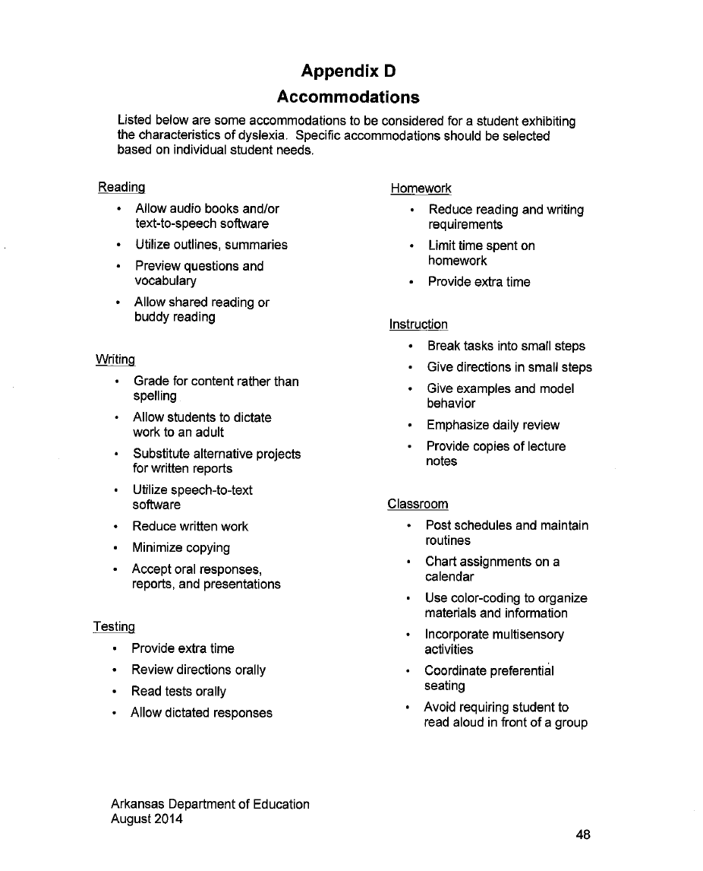
Accommodations

Slide 58
Dyslexia Resources
Arkansas Department of Education (ADE)
Dyslexia Page
Go to: http://www.arkansased.org
Click on the “D”
Select “Dyslexia”
Review Related Files

Slide 59
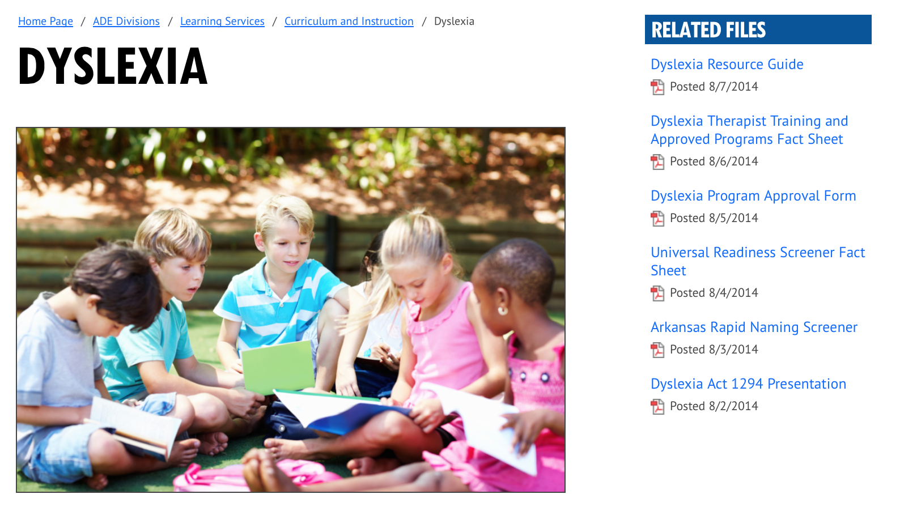
Related Files

