Slide 1
Welcome to the Arkansas Reading Association’s Annual Fall Conference!
Second General Session

Slide 2
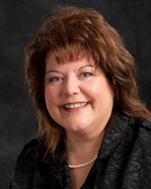
Presiding Paula Findley, ARA President

Slide 3
Please turn off/silence your phone!

Slide 4
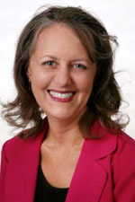
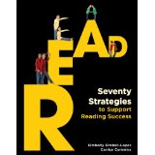
Greetings from the International Reading Association! Carrice C.Cummins President-Elect, IRA

Slide 5
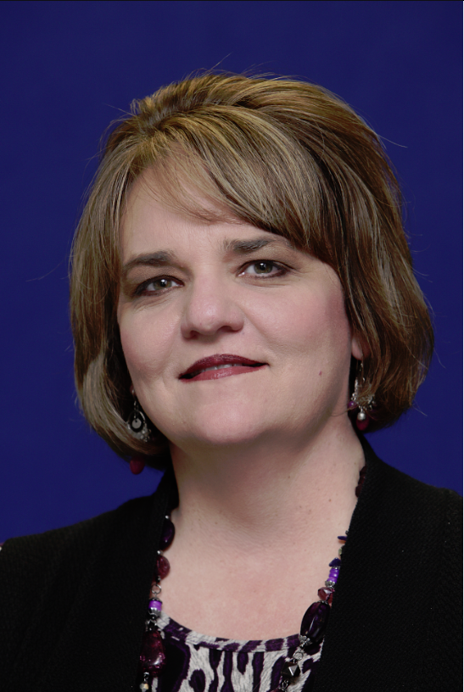
Dr. Laura Bednar, Assistant Commissioner Arkansas Department of Education Division of Learning Services

Slide 6
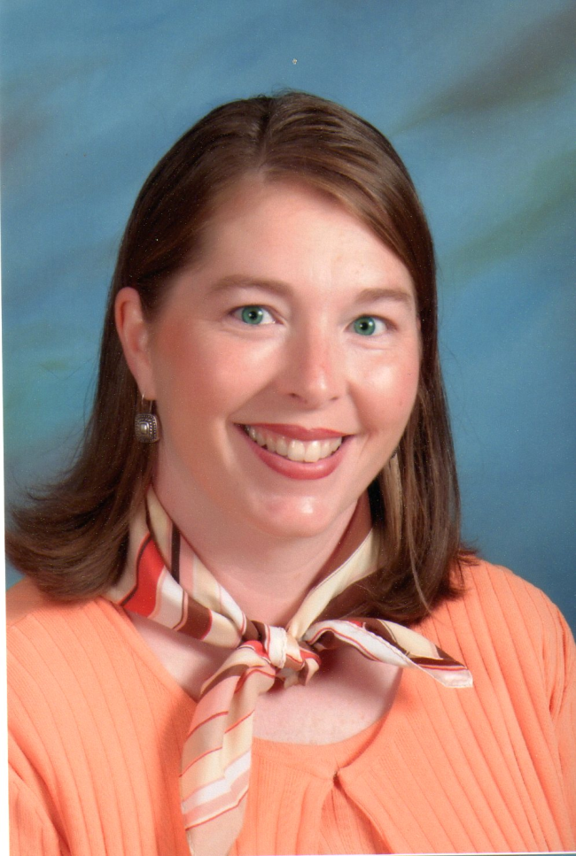
ARA Awards & Recognitions Kay Calvert, ARA Vice President

Slide 7
Jo Flanigan Scholarship
Amanda Snow
Western Arkansas

Slide 8
Studies & Research Award
Sherri Siegrist
Northwest Arkansas

Slide 9
Celebrate Literacy Award Educator
Marjorie Rosenkotter
Mountain Home Area

Slide 10
Celebrate Literacy Award Agency
Greater Blytheville Area Chamber of Commerce
Northeast Arkansas

Slide 11
Celebrate Literacy Award Community Volunteer
Mary Wallace
Northeast Arkansas

Slide 12
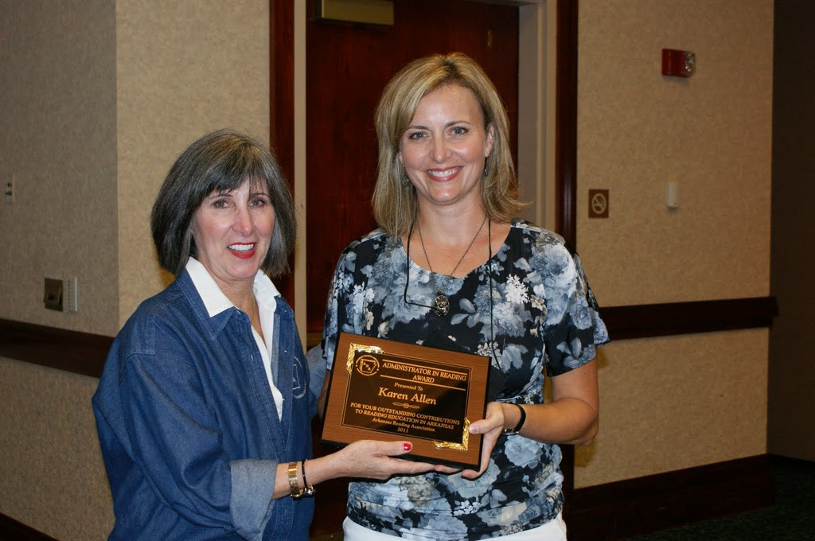
Administrator in Reading
Karen Allen
Western Arkansas

Slide 13
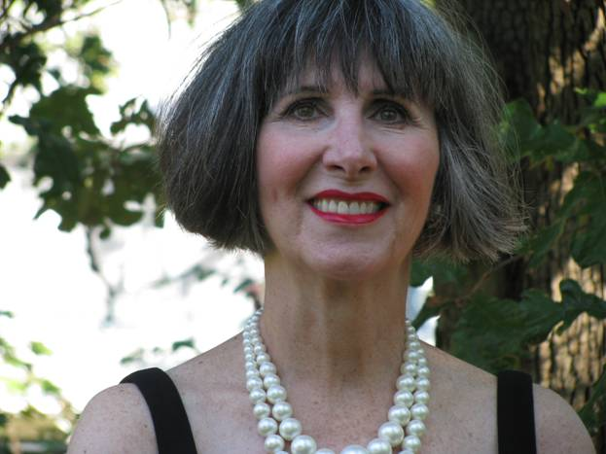
IRA Award of Excellence Arkansas Reading Association – 24 years
Linda H. Eilers
ARA President 2010

Slide 14
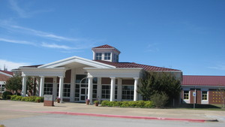
IRA Exemplary Reading Program Award Harp Elementary School, Springdale, AR
Allison Strange, Principal
Northwest Arkansas

Slide 15
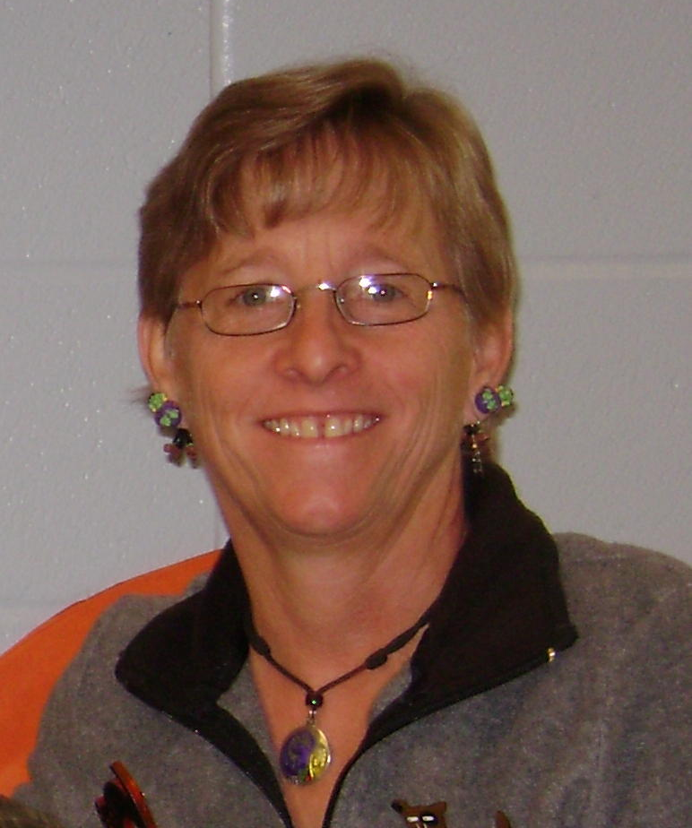
IRA Advocacy Award
Jeanne Harvey
ARA Legislative Chair

Slide 16
ARA Diamond Awards
Susan Bitely – Jefferson County
Marjorie Rosenkotter – Mountain Home Area
Renee Edwards – North Arkansas
Carolyn Self – Northeast Arkansas
Linda Massey – Northwest Arkansas
Francie Ross – Pinnacle Special Interest
Anita Skinner – SEARK
Michelle Newnum – Three Rivers
Tess Mattei – Tri-Lakes

Slide 17
IRA Honor Councils & Years
Arkadelphia Area – 12
Arkansas River Valley – 2
Central Arkansas – 26
Crowley’s Ridge – 2
Grant County – 19
Jefferson County – 17
Mountain Home Area – 1
North Arkansas – 11
North Central Arkansas - 27
Northeast Arkansas – 24
Northwest Arkansas – 18
Reading On the Ridge – 3
Pinnacle Special Interest – 2
SEARK – 19
South Arkansas – 15
Three Rivers – 19
Tri-Lakes - 20

Slide 18
2011 Local Council Honorees
Deborah McMillan – Arkadelphia Area
Amanda Austin – Arkansas River Valley
Daisy Hunt – Central Arkansas
Elisa Kifer – Crowley’s Ridge
Cindy Whitaker – Grant County
Carla Terry – Jefferson County
Anne Lichtenstein – North Central Arkansas
Marvel Dickerson – Northeast Arkansas
Laura Amos – Northwest Arkansas

Slide 19
2011 Local Council Honorees
Rosemary Underwood – On the Border
Judie Krile – Pinnacle Special Interest
Krystal Hooten – Reading On the Ridge
Tina Harrison – SEARK
Sherri Steelman – South Arkansas
Stephanie Clark – Southwest Arkansas
Anita Hogue – Three Rivers
LeAnn Robertson – Tri-Lakes
DeeDee West – Western Arkansas

Slide 20
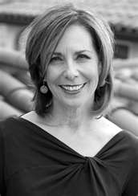
Featured Speaker Pam Munoz Ryan, Author
Why I Read & Why I Write
www.pammunozryan.com

