Slide 1
Welcome to the Arkansas Reading Association’s Annual Fall Conference!
First General Session

Slide 2
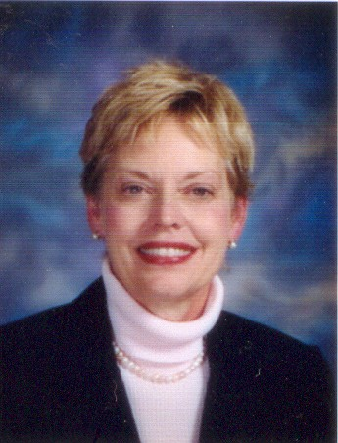
Debbie Hardwick-Smith, Presiding ARA President-Elect & Conference Chair

Slide 3
Please turn off/silence your phone!

Slide 4
Presentation of Colors White Hall JROTC

Slide 5
Pledge & National Anthem Jessica Taylor, Conway School District

Slide 6
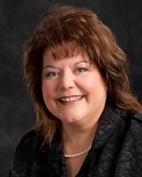
Local Council Presidents by Paula Findley, ARA President

Slide 7
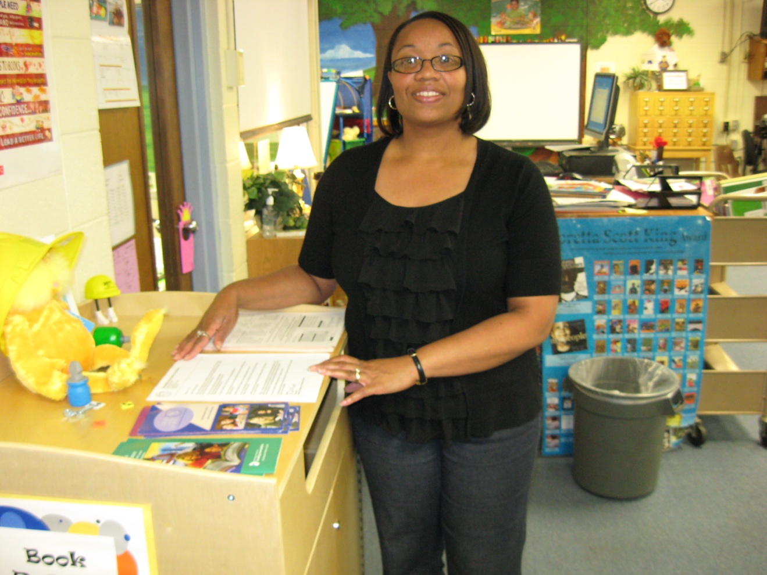
Arkadelphia Area Kaila Murphy

Slide 8
Arkansas River Valley Sandra Mitchell

Slide 9
Central Arkansas Sarah Brown

Slide 10
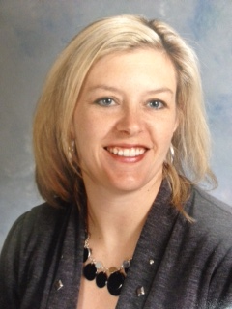
Crowley’s Ridge Brandi Wallace

Slide 11
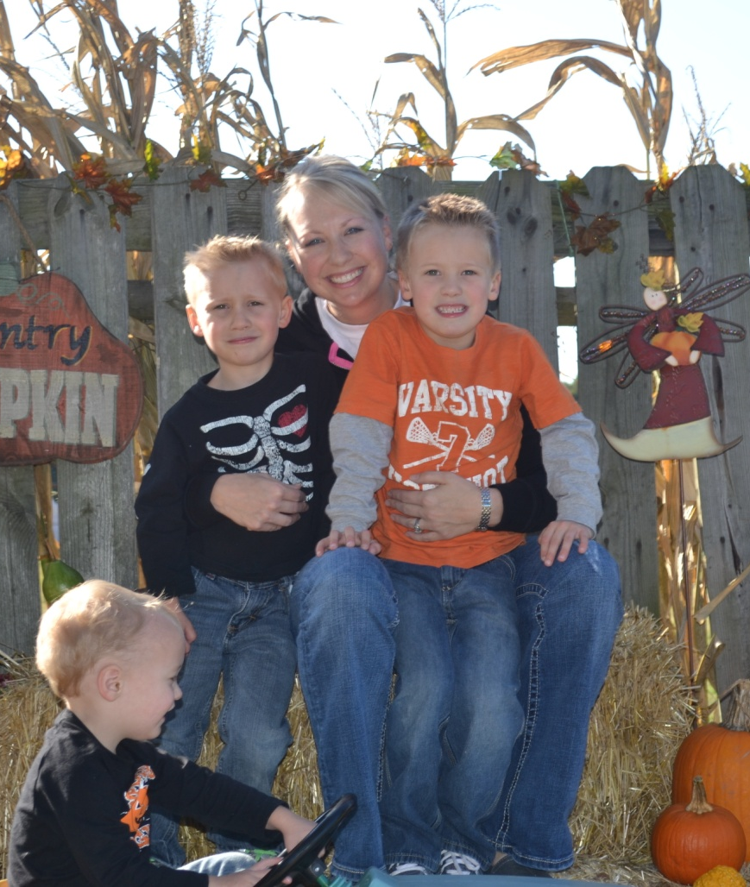
Grant County Tara Derby

Slide 12
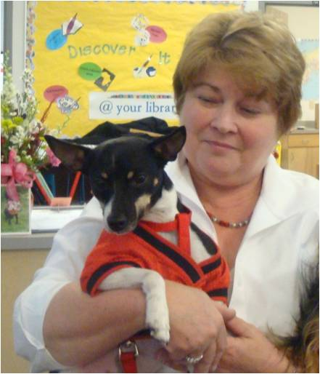
Jefferson County Susan Bitely

Slide 13
Mid-Delta Marlena Smith

Slide 14
Mountain Home Area Marjorie Rosenkotter

Slide 15
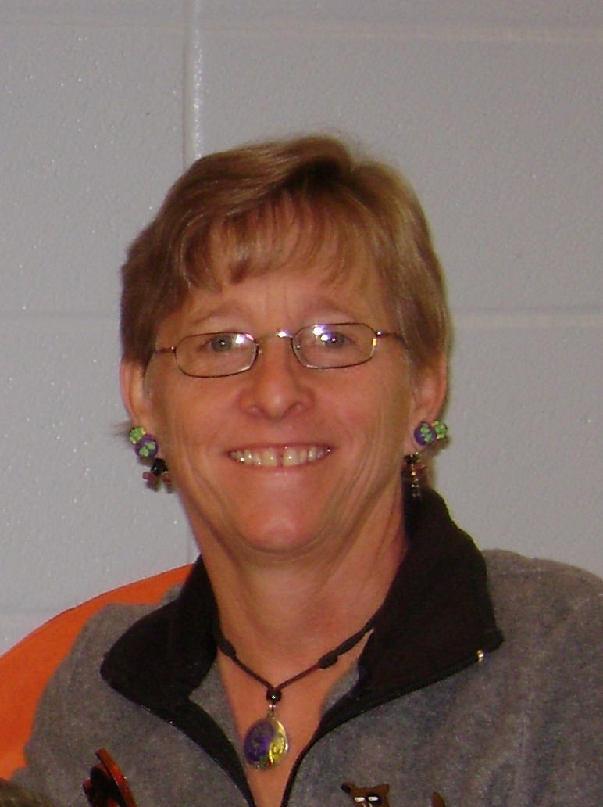
North Central Arkansas Jeanne Harvey

Slide 16
Northeast Arkansas Viola Snow

Slide 17
Northwest Arkansas Donna Owen

Slide 18
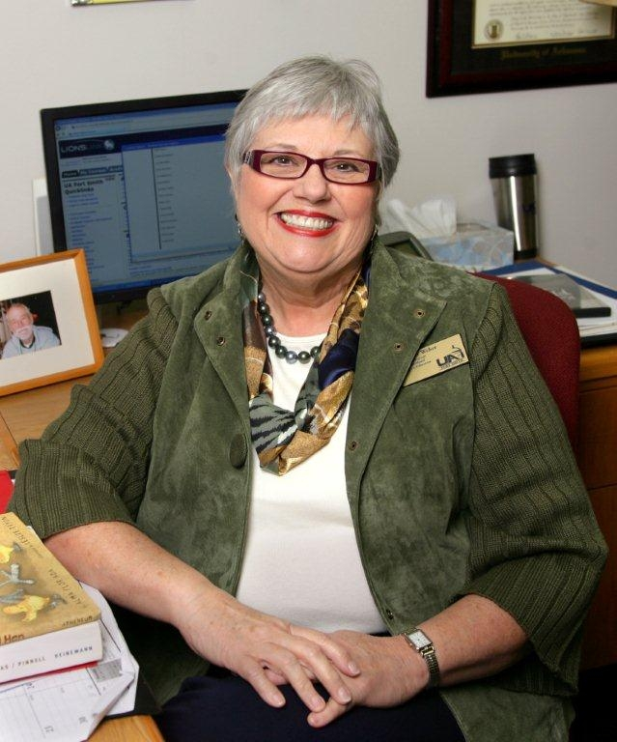
On the Border Martha Jane Weber

Slide 19
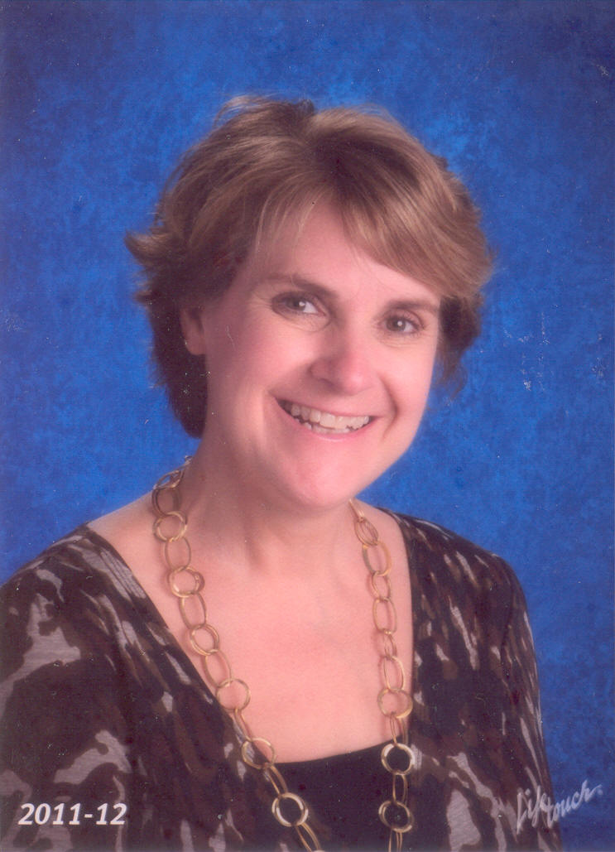
Pinnacle Francie Ross

Slide 20
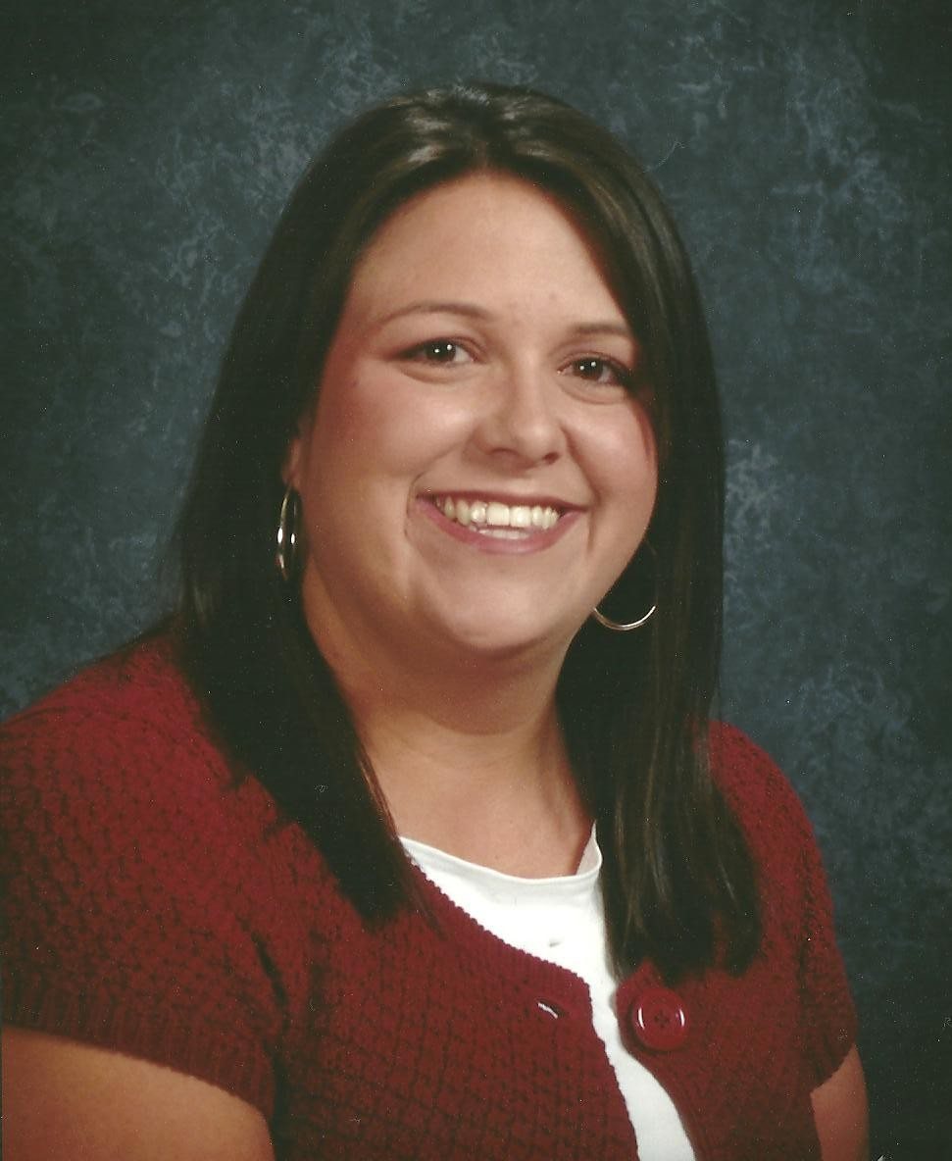
Reading on the Ridge Farrah Wilcox

Slide 21
SEARK Julie Workman

Slide 22
South Arkansas Dana Kelly

Slide 23
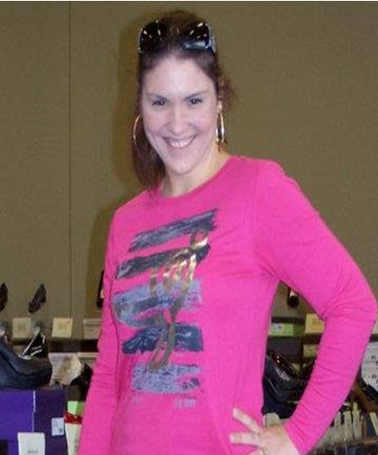
Southwest Arkansas Whitney Ivy

Slide 24
Three Rivers Michele Newnum

Slide 25
Tri-Lakes Tess Mattei

Slide 26
Western Amanda Snow

Slide 27
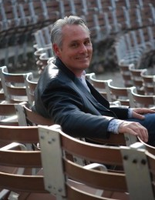
Special Music by Ron Boren

Slide 28
The Story of How One Child Can Make a Difference
http://www.kyeyac.org/

Slide 29
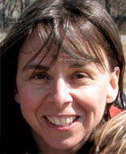
Kathy Collins
The Lenses of Our Teaching:
Seeing Clearly and Teaching
Responsively

